Slide 1
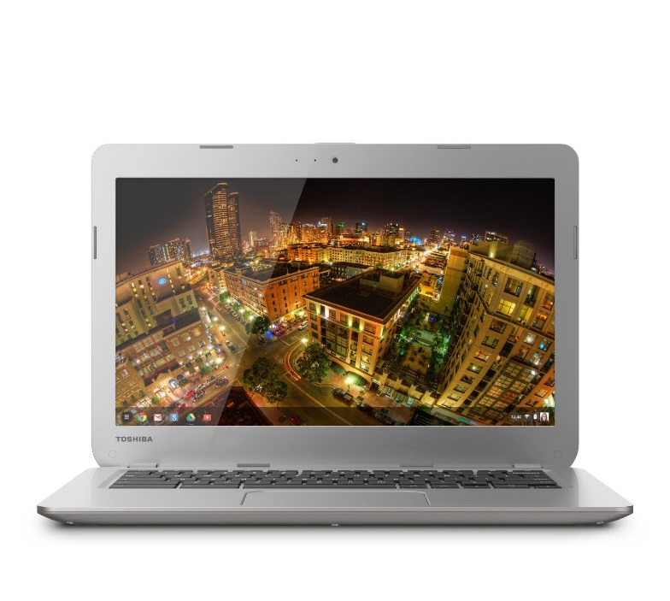
Welcome to Your Chromebook
A Chromebook is a laptop running Chrome OS as its operating system.
Chromebooks are designed to be used primarily while connected to the Internet, with most applications and data residing in "the cloud".
A Chromebook is an example of a thin client

Slide 2
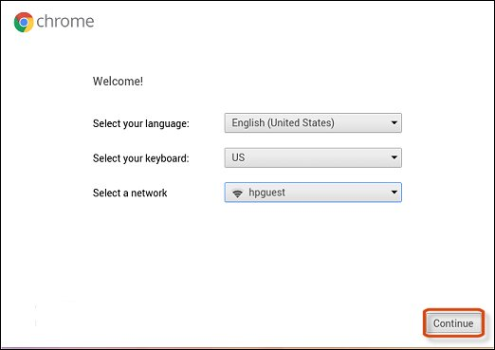
Let’s Get Started
Select a network
  PSU Secure
  Enter network the parameters
    PEAP
    MSCHAPv2
    Identity = PDX login
    Password = PDX password
  Continue
Agree to Terms

Slide 3
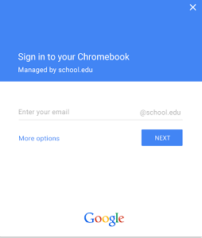
Login to Your Chromebook
Login using your PDX login (login@pdx.edu) and password
Always use your PDX login on your Chromebook for New Beginnings class related computing
There can be multiple different logins on a single Chromebook

Slide 4

Get Comfortable With Your Chromebook
Select the search key (has the magnifying glass on it)
The search window will have several icons
Explore “All Apps”

Slide 5
Chromebook Exercises
Using gmail, send me (jgraalum@pdx.edu) a short e-mail.
Enter Google Docs, create a document, and share it with me (jgraalum@pdx.edu).
Go to Google Calendar and add New Beginnings to your schedule.
Go to web store

Slide 6
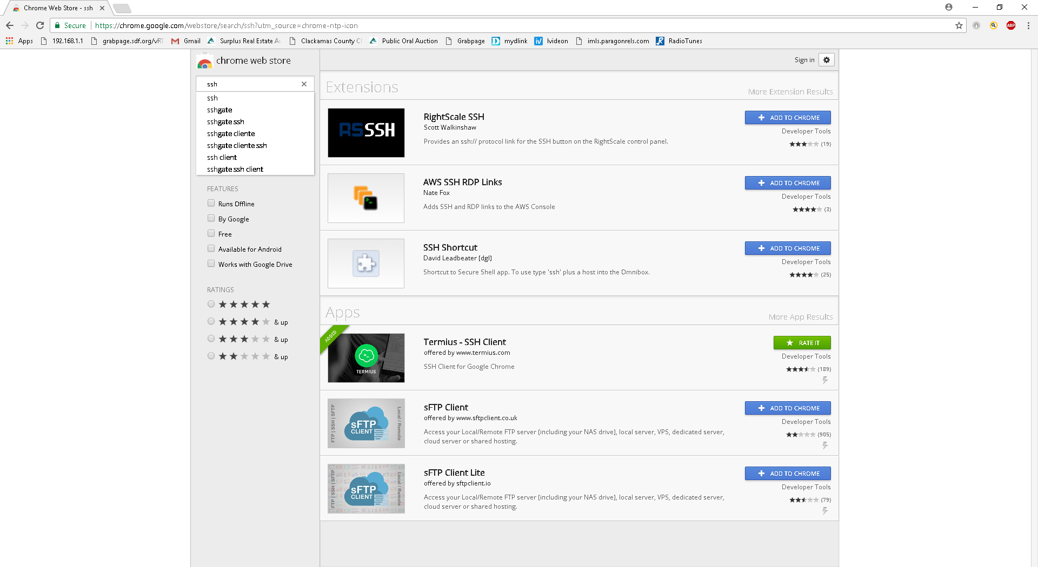
Let’s Add Some Software

Slide 7
Termius
Termius is a terminal emulator and stand-alone ssh client for Chrome.
https://www.termius.com/

Slide 8
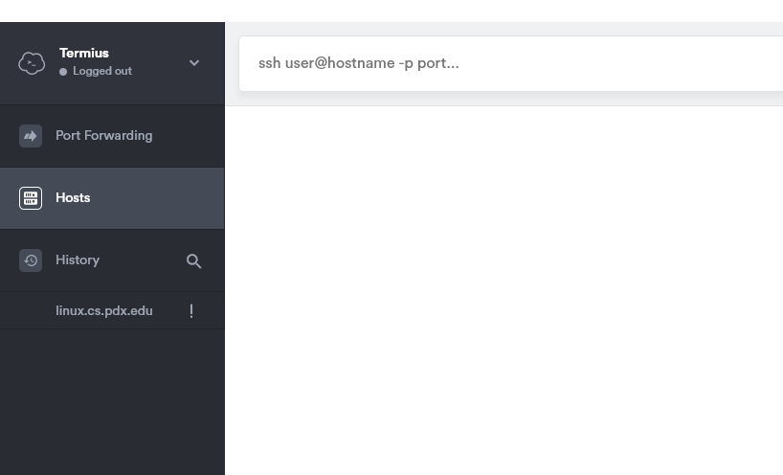
Using Termius
user@linux.cs.pdx.edu

Slide 9
Exercise 1
Login into your Chromebook
Install Termius
Use Termius to log into linux@cs.pdx.edu

Slide 10
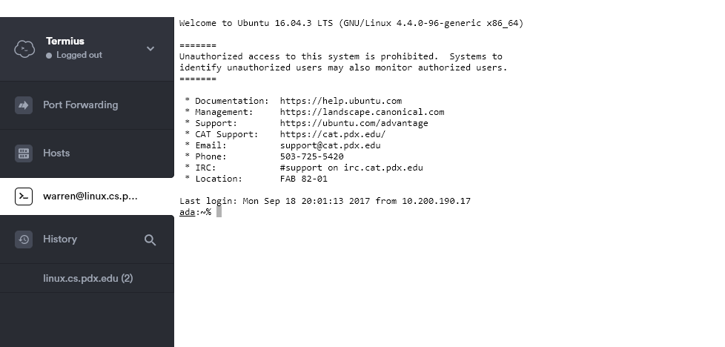
Once You've Logged In, You Should See

Slide 11
The Linux Command Line
Type commands instead of pointing an clicking
The command line gives you more control than point and click GUIs, since you can only click on the items you can point to
ada: -> This is a Prompt

Slide 12
Common commands
There are built-in commands, but new commands can be created by writing a program
session management commands
file management commands
programming commands

Slide 13
Session management
When you log into your account, you start a user session
Who else is currently logged into the computer?
  w – full list of users
  who – simplified output
Finishing your session
  exit, logout, CTRL-D

Slide 14
Exercise 2
Login
Show current users
Logout

Slide 15
Useful “filters”
Connects two programs together so the output of one program becomes the input of another – pipes (|) – stdin and stdout
Managing the output from a command
  more (page thru file, one screen at a time)
  sort (dictionary sort of file: -k for column)
  wc (count lines, words, characters)
  head, tail (first/last 10 lines)
  grep (match strings)

Slide 16
Exercise 3
Logout
Log back in
Pipe the "w" command thru more:
w|more
…

Slide 17
File management
creating, removing and manipulating persistent storage
What files are there?
  ls
Create a file of your own
  nano myFile
Showing the contents of a file
  cat myFile
Making a copy of a file
  cp myFile aboutMe

Slide 18
Using nano
https://www.howtogeek.com/howto/42980/the-beginners-guide-to-nano-the-linux-command-line-text-editor/

Slide 19
More File management
Renaming a file
  mv fname1 fname2
Removing a file
  rm fname
Options
  man nano

Slide 20
Programming Commands
Text Editors
  allow you to create and modify files of text
  nano fname
Printing a file (you’re subject to a quota – see http://cat.pdx.edu/students/printing.html)
  lpstat –a
  lpr –P printer fname

